Slide 1

Gene therapy for Duchenne: the long and winding road Pauline mccormacK peals research centre newcastle university
2nd International Summit on Human Genome Editing, 2018

Slide 2

DMD
One of commonest rare diseases
Severe, progressive, life limiting
High care burden on family
Notes:
Duchenne muscular dystrophy (DMD) is a severe, progressive disease that affects 1 in 3600–6000 live male births

Slide 3
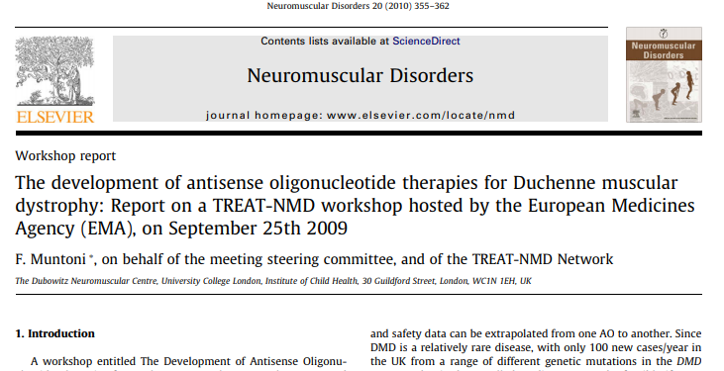
Therapies for DMD
Notes:
Start with a promissory technology quote
For sociologists like me we are talking about this in the abstract, with absolutely no idea how it might play out in the real world, and therefore no real idea of how it might affect people with diseases all the families. And that is really all our goals to help people with diseases?

Slide 4
Promissory technologies
‘An imaginary is a collectively embraced actionable future in which technological change will bring about certain positive, culturally intelligible results’ (Weiner et al 2017)
Bench to bedside is rarely linear progression with reduction in uncertainty
Translation into clinical care can introduce complexity and new uncertainties
Discrepancy – imagined and actual - disruption
Notes:
Kate Weiner in a recent article looked at the discourse and developments around the ‘geneticisation of society’ debate over the last 25 or so years. We conclude that while the specific expectations embedded in the geneticisation thesis have not been realised, a powerful genetic imaginary persists. Referencing Sheila Jasanoff she says “An imaginary is a collectively embraced actionable future in which technological change will bring about certain positive, culturally intelligible results”
Assumptions are often made that novel technologies will map directly onto real world experience, in a predictable and linear fashion while history shows us that the application of new health technologies is rarely one of step-wise improvements, accompanied by a reduction in uncertainty. Discrepancies between the promised benefits of the genetic imaginary and actual experience can lead to unintended consequences (Winner 1986, Wynne 1996) and a lack of trust and consensus among the actors involved, all of which can be disruptive to the implementation and acceptance of the new technology. (Nelis chpt 10 contested futures). Ambitious programmes of change are necessarily aspirational but a revolution in approach must begin at a particular point in time and with a discrete set of implementations
For sociologists like me we are talking about this in the abstract, with absolutely no idea how it might play out in the real world, and therefore no real idea of how it might affect people with diseases all the families. And that is really all our goals to help people with diseases?

Slide 5
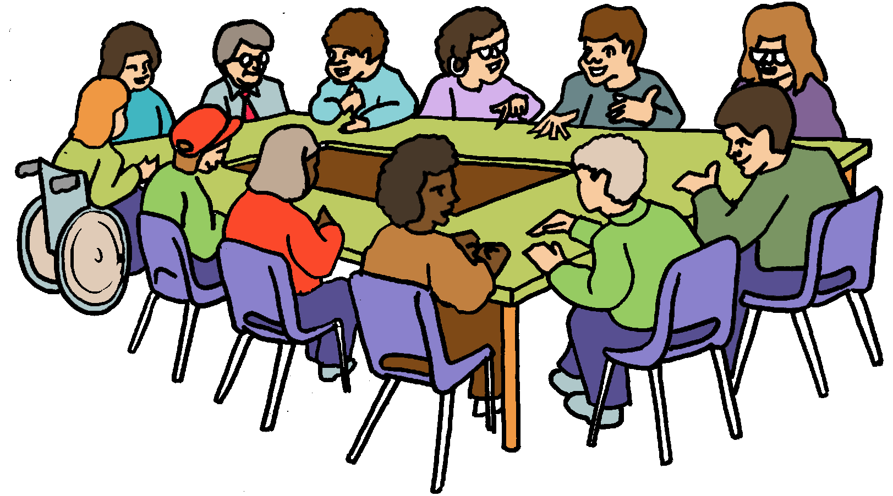
Where are we now?
Multiple problems, increased complexity
2 (restricted) therapies
Clinical benefit not proven
“shifting sands and blind alleys that may disorient the modern orphan drug developer as well as the families” (Hoffman & McNally 2014)
Notes:
So back to 2009

Slide 6
How we talk about genome editing
We are talking about genome editing in positive tones
‘enormous positive potential’
for DMD, ‘great hope’
Disadvantages may become advantages
“I hope you’re right, I really do”

Slide 7
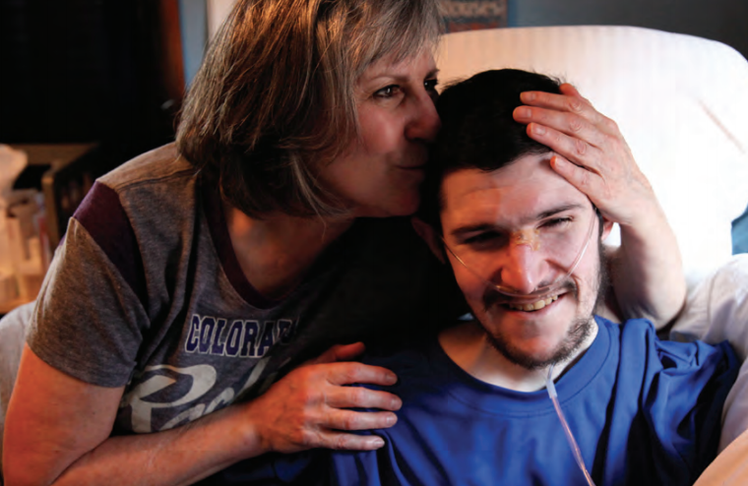
Promissory technologies
‘what is dangerous is where there are asymmetries of power, information or representation in the public sphere that mean that certain visions and values go unappreciated and others go unchallenged’ (Nuffield Council on Bioethics 2016)
Better QoL and significant increase in life expectancy for people with Duchenne has come via improved care

Slide 8
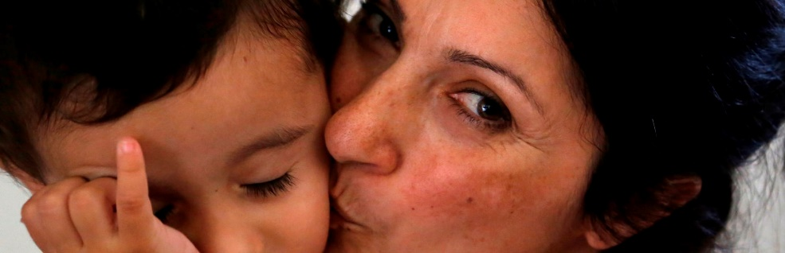
Press on with caution
Similar uncertainty/complexity 100,000 Genomes
A decent genetic minimum for rare disease
Aspiration –versus– actuality
Under-promise, over-deliver

Slide 9
@paulinemacco Pauline mccormacK peals research centre newcastle university
International Perspectives PPI, 2018

